Slide 1

AgriTech IoT
By Team Insight
In Collaboration with Centre for Technology Infusion

Slide 2


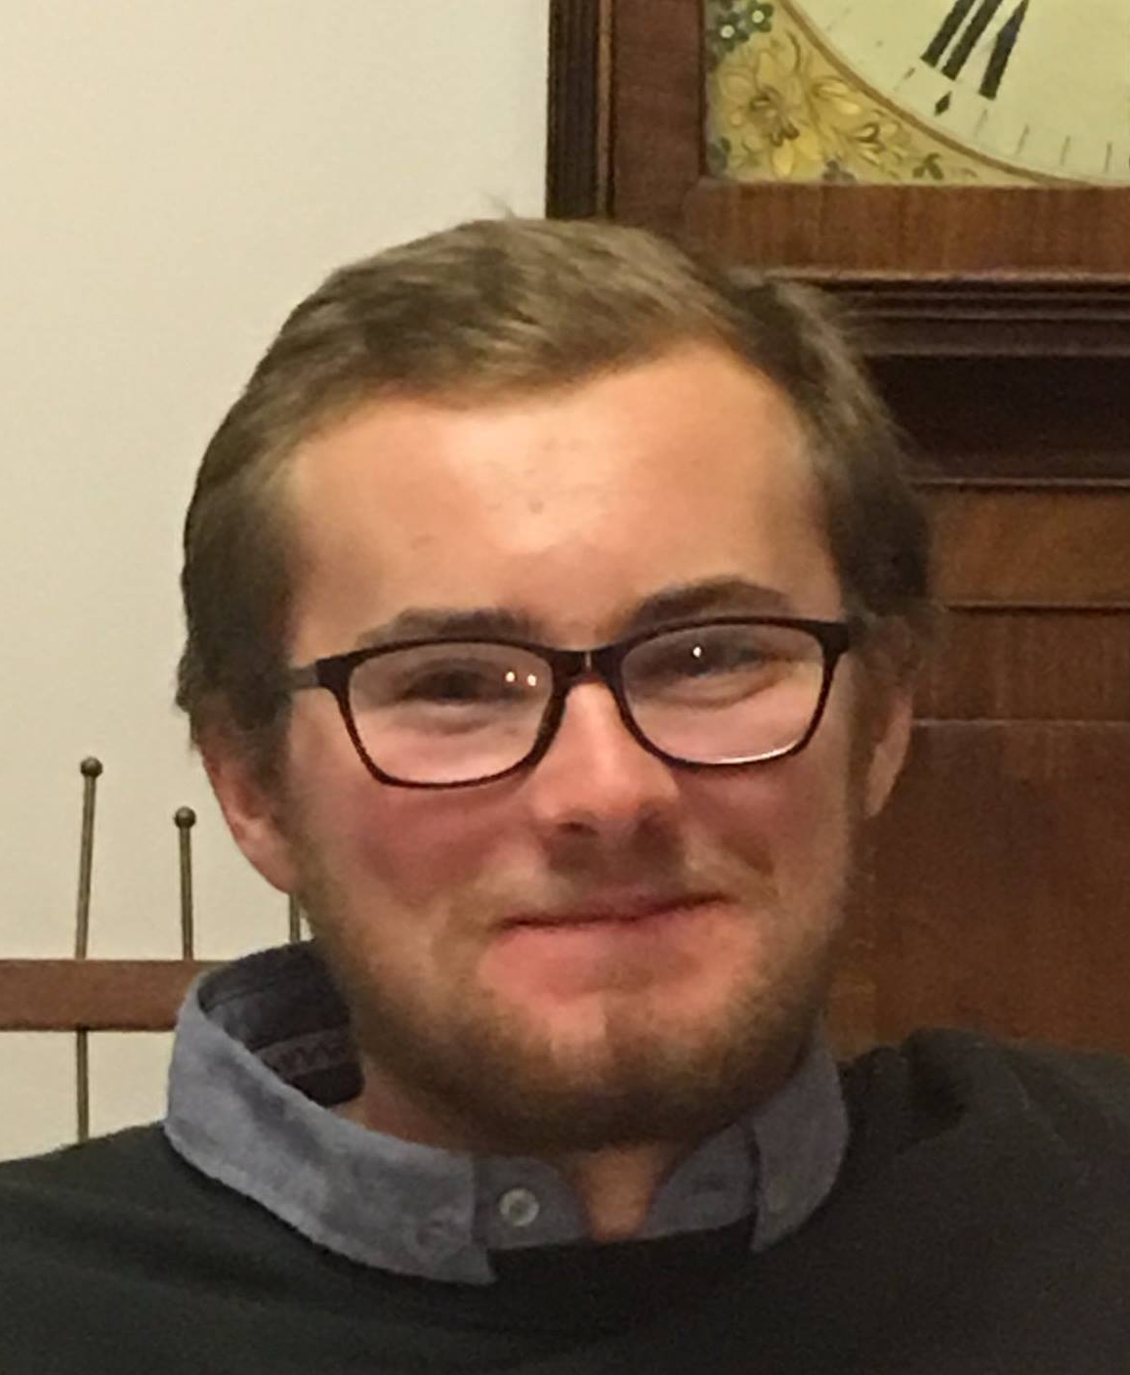
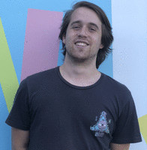

About our Team
M Alicia Hadisaputra – LoRaWan Gateway & Cloud administrator, Team Assistant
Mona Abedi – Machine Learning & Database administrator, Team Leader
Liam Maguire – Frontend developer/designer
David Wisniewski – Hardware developer
Milind Rajpoot– Hardware developer

Slide 3
Outline
Project Overview
User Stories
Project Solution
Sensor – Demo
Project Summary (Requirement & Constraints)
System Architecture
Sprint Implementation
Last Sprint Report
Burntdown chart
Matrix of completion
Confluence
Goals for next semester
Gateway – Demo
Machine Learning – Demo
Dashboard - Demo
Bitbucket

Slide 4
System Overview
Core system design remains the same
Hardware design has improved over time
Front end remains consistent
Constraints

Slide 5
Sprint Planning
Sprint 5 Summary
Sprint 6 Summary
Seeeduino technical difficulties

Slide 6
User Stories
"As a farmer I want to monitor the movements of individual animals and recognise activities"
Acceptance criteria
13 story points
Team effort

Slide 7
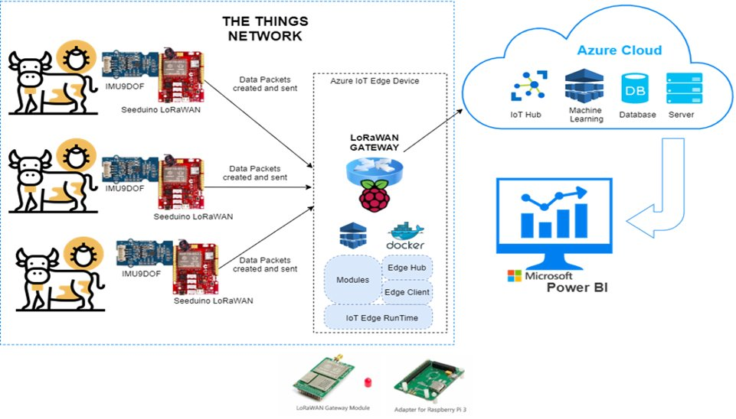

SYSTEM ARCHITECTURE
Final Data Ready
for our end-user

Slide 8
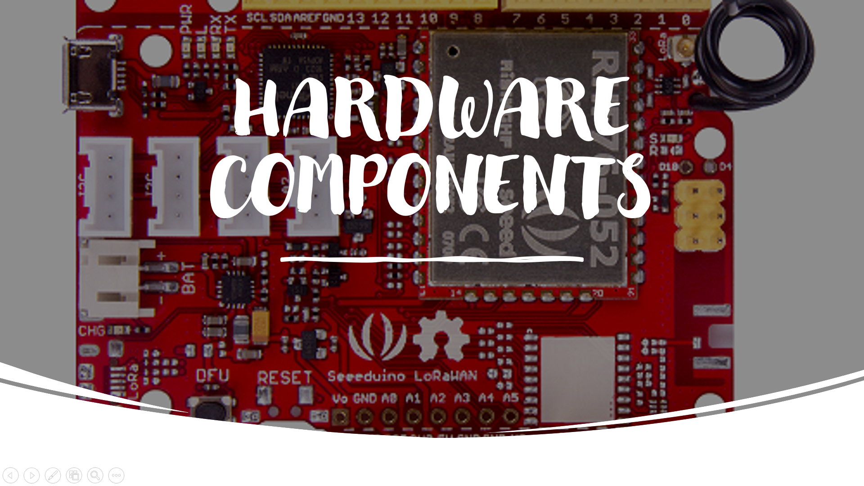

Slide 9
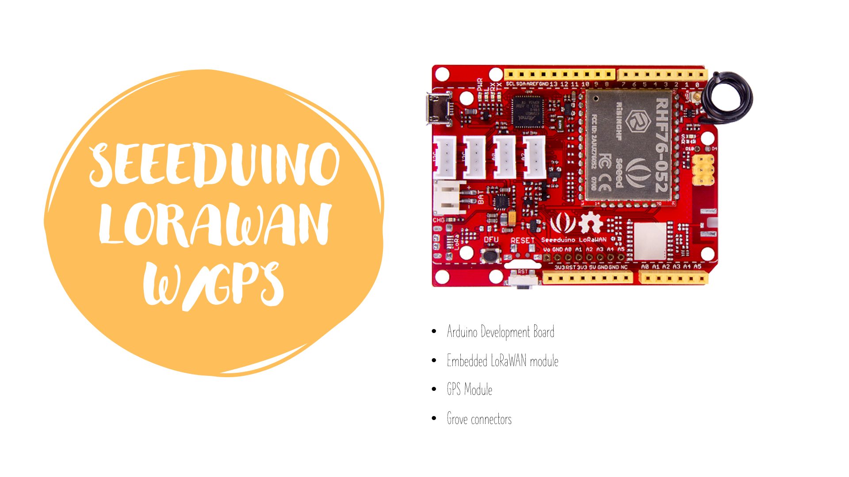

Slide 10
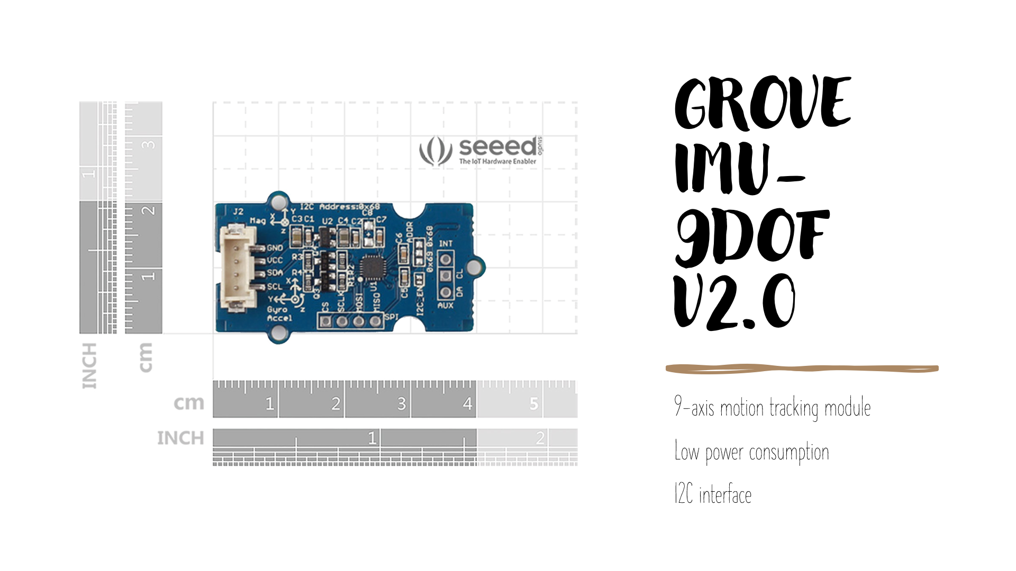

Slide 11
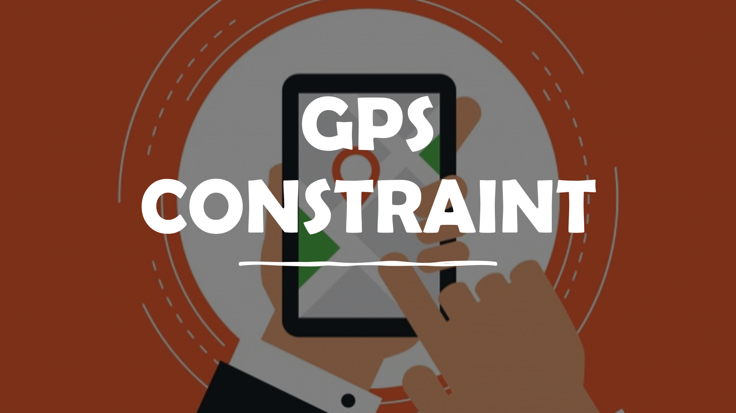

Slide 12
Gateway Communication
Notes:
In the previous presentation, I have listed the modules that will be running on the on the IoT edge. Now, I will talk about packets and its encryption, and the communication between the nodes and modules.

Slide 13




Packets
The data is encrypted along the whole journey, first by a Network Session Key (NwkSKey) and then via an Application Session Key (AppSKey).
Data
Data + NwKSkey
Data + NwKSkey + AppSKey
Notes:
LoRaWAN data begins life as a wireless LoRa radio transmission from Device to Gateway. There it is sent to a Network Server in the cloud. The data is encrypted first by a network session key, then via an Application session key. But where do NetSessionKey and AppSessionKey come from?

Slide 14


OTAA (Over-The-Air Activation)
ABP
(Activation By Personalisation)
VS
JOIN REQUESTS
LOST Re - Join
PRE - PROGRAMMED
PRE - REGISTERED
Notes:
It actually Depends on the "activation" method, OTAA or ABP
To activate, the device sends a join request and uses the join response to derive the session keys. However, If they are lost or the network chooses to expire them, the device must re-join to generate new keys.
FOR ABP the session keys, are preprogrammed into the device and the device is pre-registered on the network.
For this project, we are using ABP activation.

Slide 15
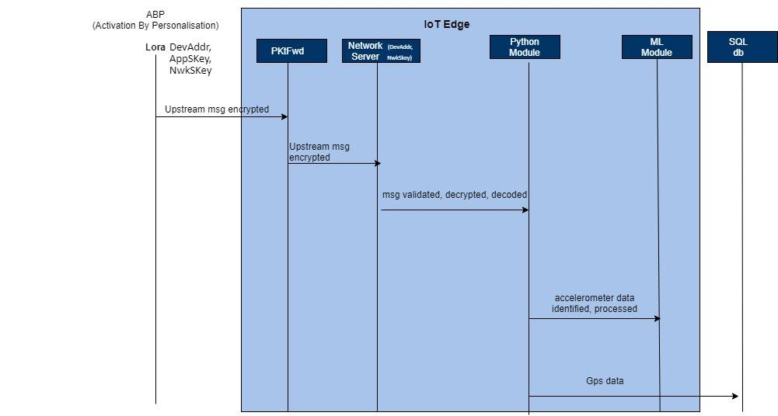
Sequence Diagram
Communication between the Lora device, IoT edge Modules, and the Database.
processed data
Notes:
As we can see, these keys(devvadd,appskey,nwkskey) are pre programmed on the lora device also pre registered on the network server.
So the encrypted upstream msg sent from the lora device, received and forwarded by the pktfwd/loraconcentrator to the Network Server. There, it recognizes the network session key then validate, decrypt and decode the message.
In our python module, we then separates the data. GPS data will be stored in the database, whereas accelerometer data is processed in the ML module then sent to the SQL database

Slide 16
Problem for accelerometer-based activity recognition
The problem is to predict what an animal is doing based on a trace of their movement using sensors.
Animal Activities are defined by :
Walking , Grazing , Rumination ,Licking , Idle
Machine Learning
Machine Learning
Purpose of applying Machine Learning to sensor data
By applying machine learning to sensor data, farm management systems are evolving into real time artificial intelligence enabled programs that provide rich recommendations and insights for farmer decision support and action.
Objective
High recognition accuracy
Low computational cost

Slide 17
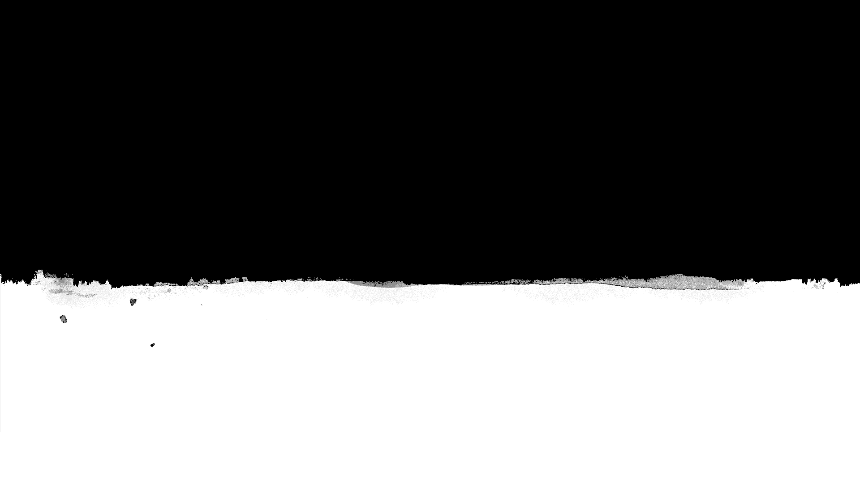
Problem’s characteristics:
Time series
Classification
Supervised leaning
Implementation
The innovation of convolutional neural networks is the ability to automatically learn many filters in parallel specific to a training dataset
Convolutional Neural Network
Pre-processing data
- Remove outliers
- Windowing /Framing
Fit the model
CNN is suitable for time series classification require that data be prepared in a specific manner in order to fit a model

Slide 18
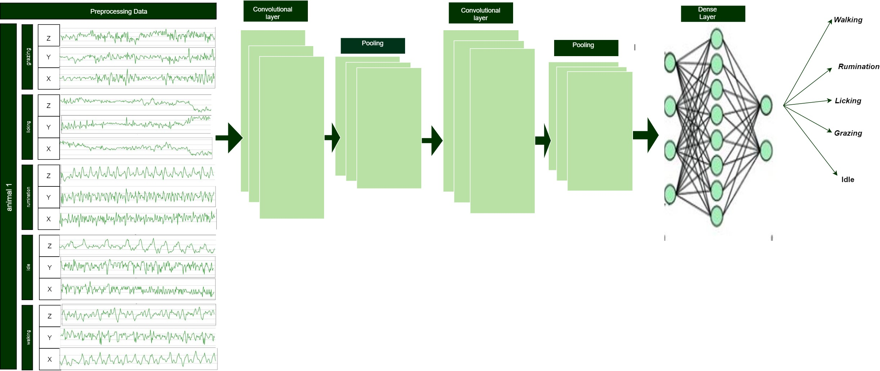
In the first layer we have 50 filters and the filter size is 10. We need to pass the input in the first layer then we implement maxpooling with size of 2.
For hidden layer we have 25 filter and filter size is 1. We don’t need to pass input in this layer and then implementing the maxpooling of size 7
For the Dense layer which is output layer we have 5 different classes and we have softmax activation function
In order to feed the data into our neural network, data must be reshaped as below:
Sample rate=30 HZ
1 window =1 sec
Time-steps(frame-size)=30
Steps(hop-size) =30 which means we don't have any overlapping
A single window is 2 dimensions array = [time-steps, features]

Slide 19
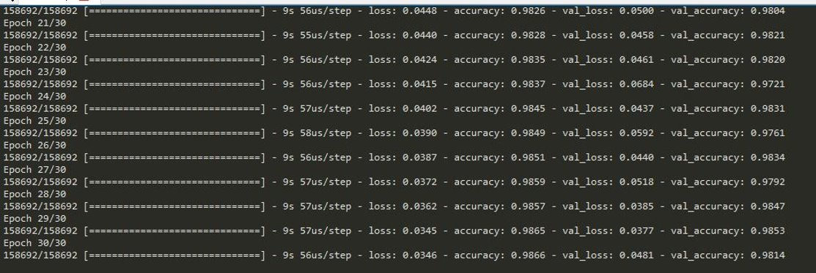
Measuring Accuracy:
Measuring Accuracy:

Slide 20
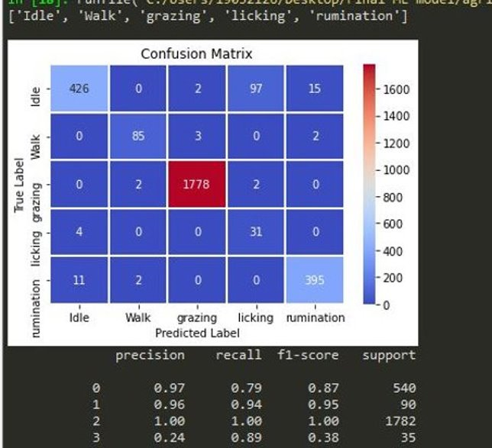
Testing data Accuracy and confusion Matrix

Slide 21
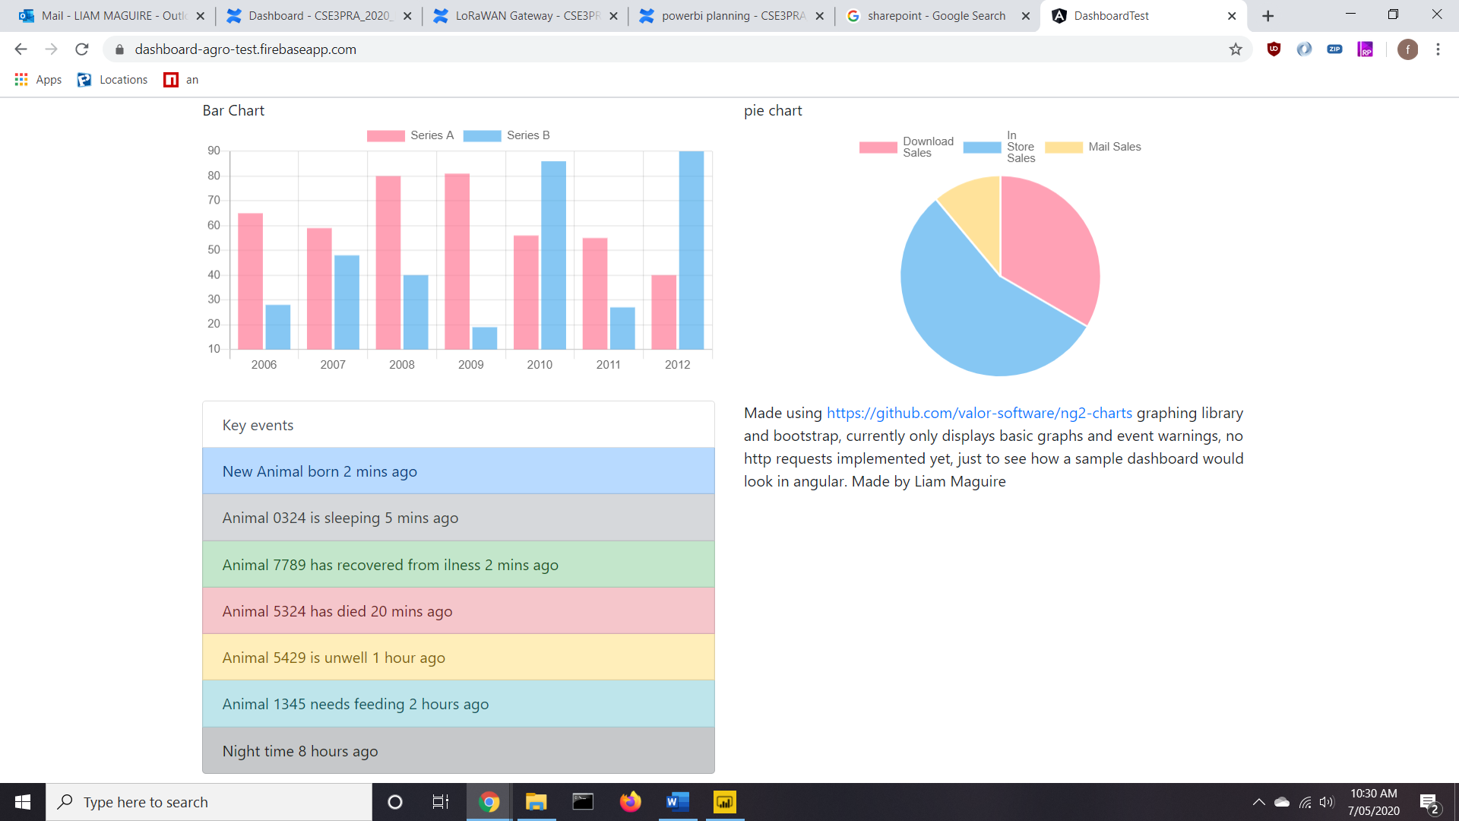


LoRaWan Gateway
Power BI
DashBoard

Slide 22
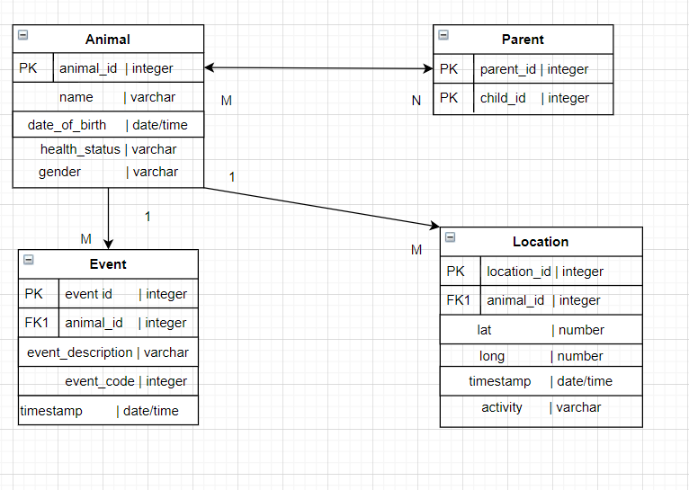

Slide 23
DEMO

Slide 24
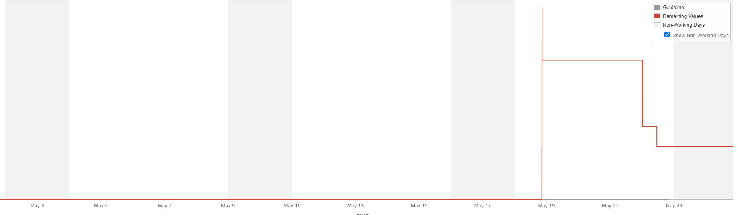
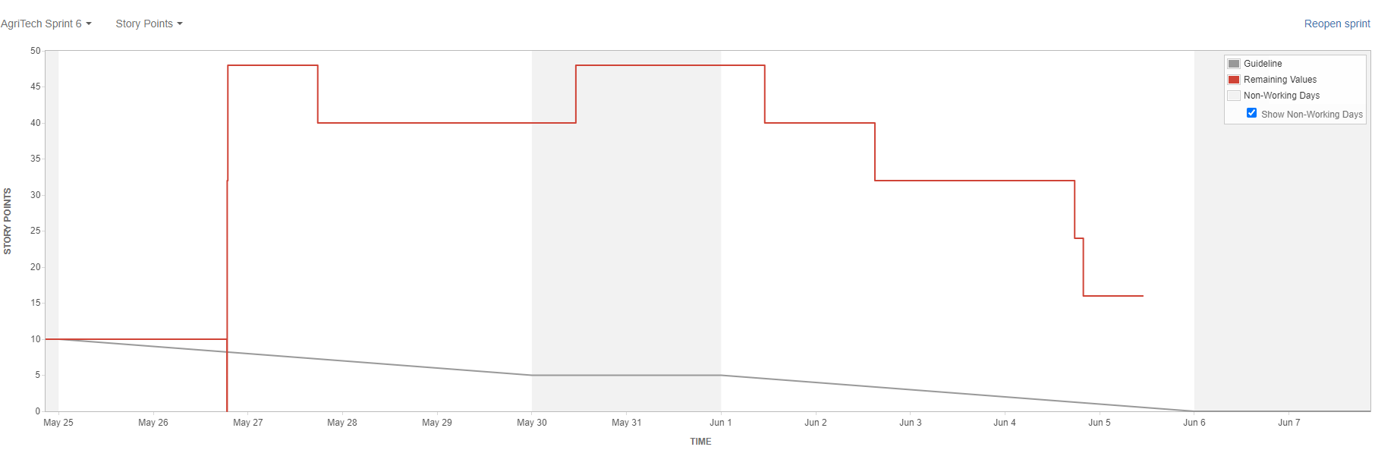
Agile Maturity
Primary focus of sprints
Burndown charts
Sprint 5 burndown by story points
Sprint 6 burndown by story points

Slide 25
Conclusion
Areas to improve upon
Plans for semester 2

Slide 26
Q&A

